Slide 1
Git
Software process

Slide 2
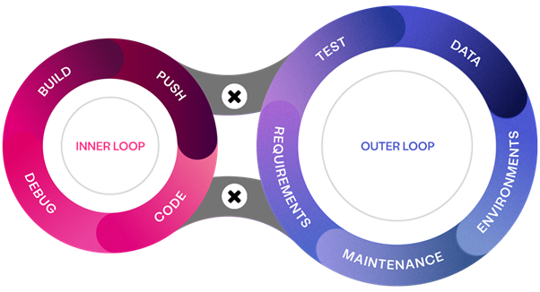
Inner and Outer Loop
Inner loop should be fast (being able to do the loop multiple times per day)
Outer loop is slower, daily, weekly, monthly

Slide 3
Branches, Tags, and Releases
Branches = Versions – Parallel versions of your project
Main Branch – The stable, primary branch
Feature Branches – For new features or fixes, separate from main
Owned by developers
Release Branches
Owned by the release manager
Merging – Combines branch changes back into another
Local vs. Remote – Branches exist on your machine or in a shared repo

Slide 4
Branches, Tags, and Releases
Tags = Snapshots – Mark specific points in Git history
Lightweight – Just a named pointer to a commit
Annotated – Store extra info like messages, author, and date
Common Use – Used for versions (e.g., v1.0, release-2024)
Permanent – Unlike branches, tags don’t change or move
Must be pushed to the server just like branches

Slide 5
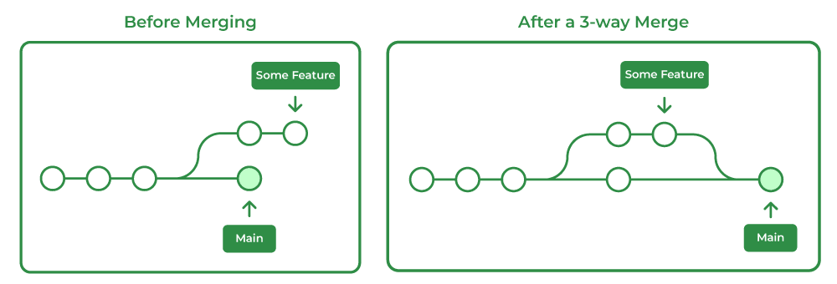
Merging

Slide 6
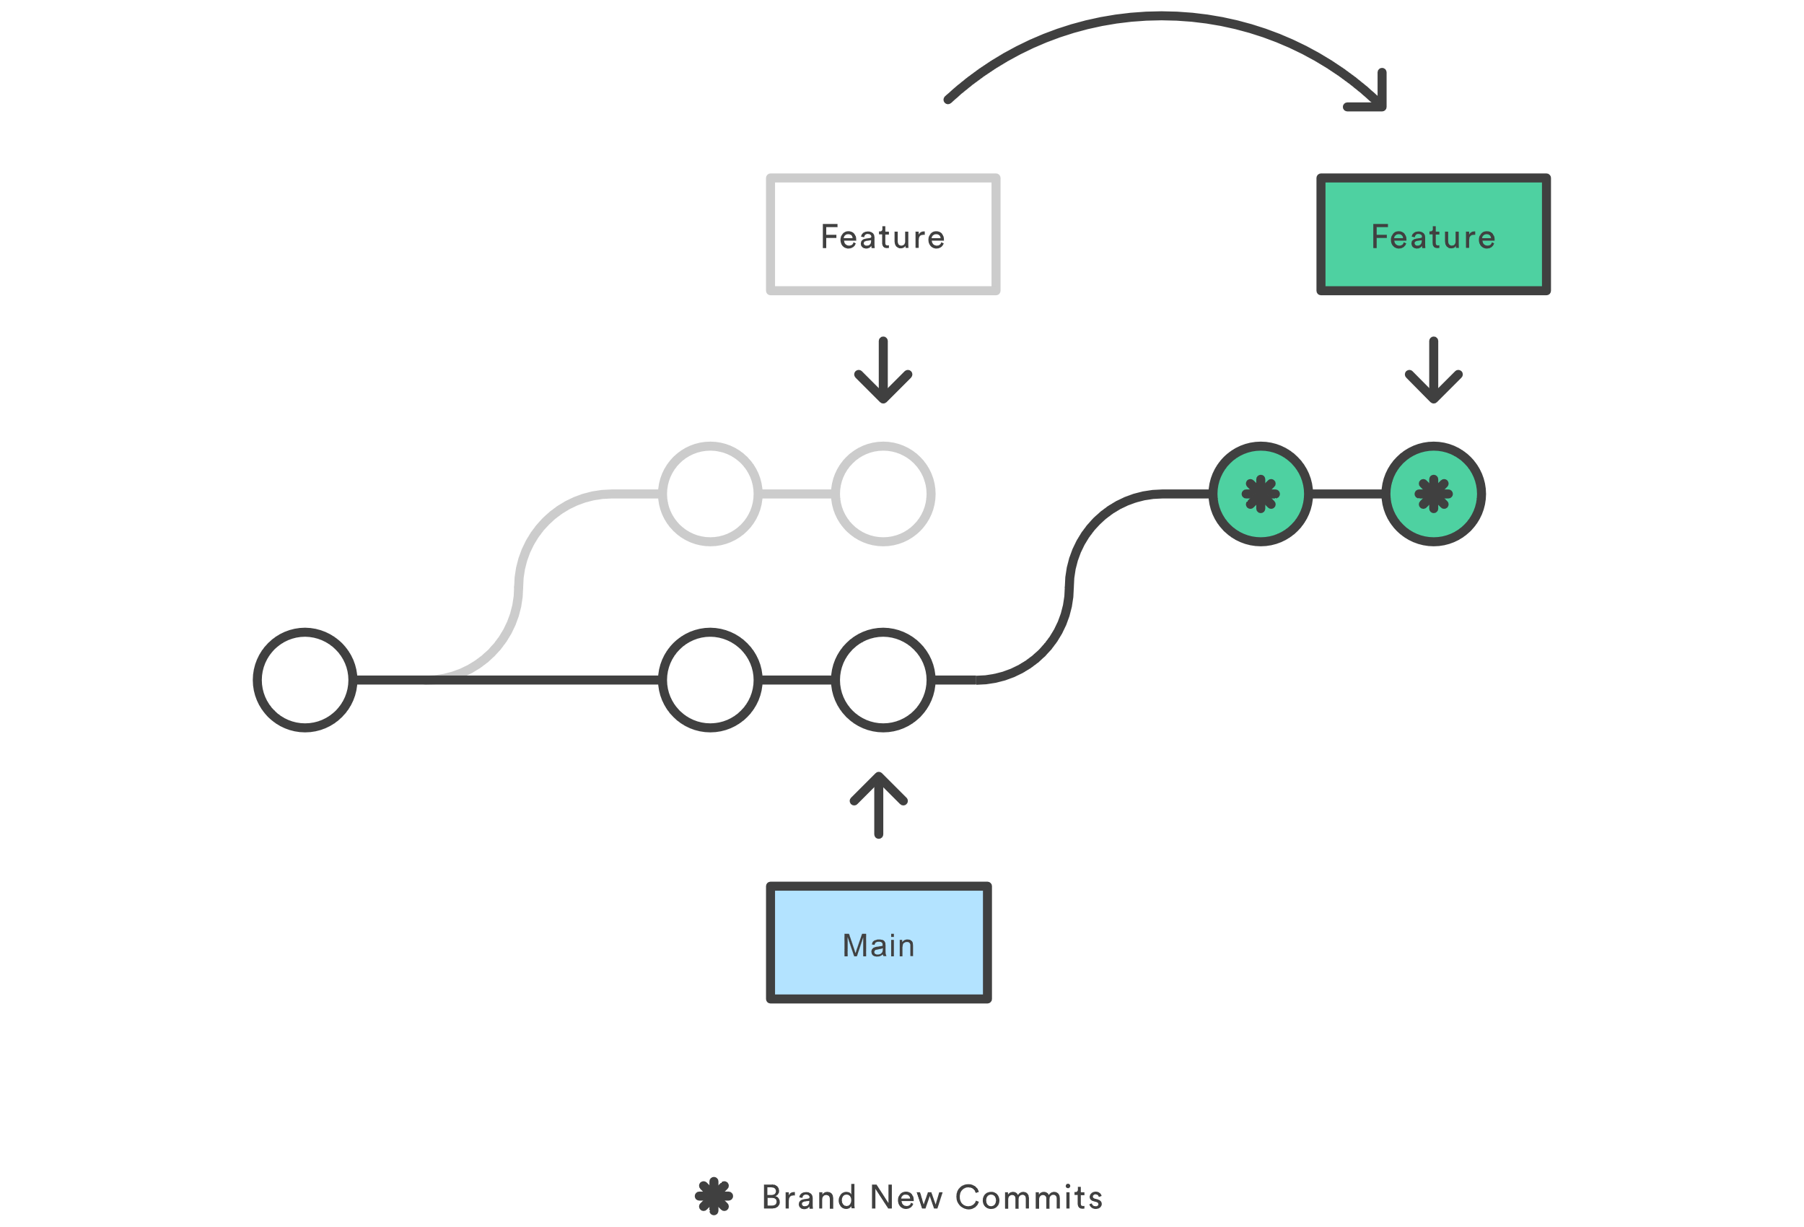
Rebasing

Slide 7
Tags
git tag – Show tags
git tag <name> – Create tag (not pushed, and at current position)
git push origin <tagname> – Push tag onto the server
git push origin –tags – Push all tags
git show <name> – Show information about a specific tag
git log --pretty=oneline – Show recent commits
git tag v1.2 9fceb02 – Tag a specific commit
git checkout <tagname> – Same as checking out a branch
git tag -d <tagname> – Delete a tag
git push origin :<tagname> – Delete a tag from the server
git push --delete origin tagname – Delete a tag from the server

Slide 8
Rebasing in git
git rebase origin/main
“Squashing” changes
git rebase -i HEAD~X

Slide 9
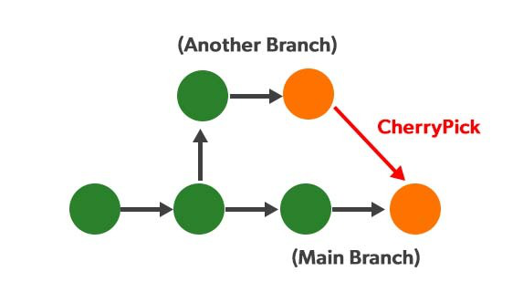
Cherry-pick
When you want a specific commit, not the entire branch
Often used for hotfixes

Slide 10
Stashing
Temporary storage of changes
git stash
git stash apply
git stash pop

